Slide 1
Occupational Safety and Health in India: Now and the Future
Shyam Pingle (April, 2012)
Seminar by Rushikesh Jogdand (2016A4PS0147G)

Slide 2
Introduction
Occupational safety and health (OSH) for India is a 'development tool' and an empowering movement.
As a result of globalisation, Indian industry is exposed to the latest trends in OSH. Progressive industries have launched many initiatives to spread awareness on OSH among all stakeholders and to reduce OSH risks at workplace. Large number of companies have a corporate health, safety and environment (HSE) policy and have opted for various certifications in OSH. However, majority of Indian population is engaged in unorganized sector.

Slide 3
Literature Review

Slide 4
Literature Review
Occupational Safety and Health in India: Now and the Future, Shyam Pingle (April, 2012)
DG FASLI Website [http://www.dgfasli.nic.in]
IAOH Website [http://www.iaohindia.com]
The Factories Act, 1948 (India)
The Mines Act, 1952
DGMS Website [http://www.dgms.gov.in/]
ESIC Website [https://www.esic.nic.in/]

Slide 5
Analysis

Slide 6
Analysis : Overview
who is affected (the demographics)
major occupational diseases and hazards in India
OSH laws and policies in India
implementation of laws and policies by government
industry compliance and initiatives
OSH professionals and organisations in India
summary of OSH issues in India
current and future needs (recommendations)
emerging challenges and paths

Slide 7
Who is affected?
out of India’s population of more than 1.2 billion^{(census 2011)} , 63.6% form working age group.
more than 90% work in informal economy — agriculture and services : ~60% self-employed, ~30% without regular jobs
remaining less than 10% work in organized sector — mainly manufacturing, mining and some services

Slide 8
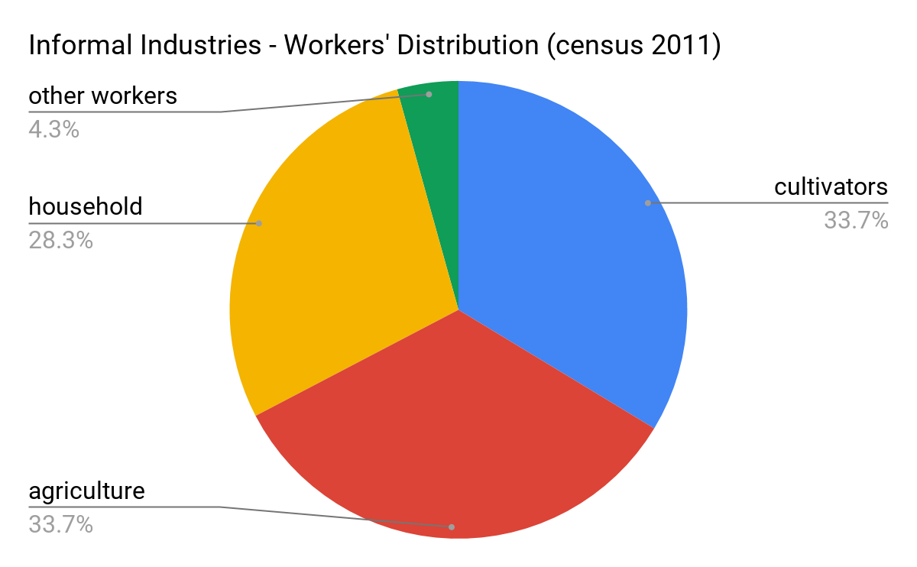
Where do non-regular workers work?

Slide 9
Major Occupational Diseases and Hazards in India
accidents
pneumoconiosis – lung disease due to dust, especially silicosis caused due to inhalation of crystalline silica dust i.e. fine ash, sand dust
musculoskeletal injuries – body pains, arthritis, etc
chronic obstructive lung diseases
pesticide poisoning
byssinosis – lung disease because of inhalation of fibre dust
asbestosis – lung disease resulting from inhalation of asbestos particles
noise induced hearing loss
workplace stress

Slide 10
Major Occupational Diseases and Hazards in India
Some trends
Women are subjected to indoor air pollution due to biomass fuels
Working women are subjected the dual burden of home work and occupation
Agriculture, mining and construction have high levels of accidents and diseases.

Slide 11
OSH Laws and Policies in India
India has 16 Laws related to working hours, conditions of services and employment. The major legal provisions for the protection of health and safety are contained in two acts: the Factories Act (1948, amended 1987) and the Mines Act (1952, amended 2016).
India also has social security and health insurance scheme for lower wage workers governed under the Employees’ State Insurance (ESI) Act, (1948, amended 2016).

Slide 12
OSH Laws and Policies in India : The Factories Act
pre-employment and periodic medical examination
mandatory, periodic monitoring of the work environment in those industries defined as hazardous
maximum permissible limits for a number of chemicals
to be implemented by the State Factory Inspectorates
similar provisions for mines act
applicable only to factories employing 10 or more workers — covers ~13 million workers

Slide 13
OSH Laws and Policies in India : ESI Act
applicable to non-seasonal factories employing 10 or more persons
wage limit for coverage under the Act is ₹ 21,000 per month
employees covered — 31.1 million (2018)
benefits —
medical care
sickness - 70% pay compensation
maternity benefit
dependent benefit
rehabilitation, old age medical care

Slide 14
OSH Laws and Policies in India
other provisions for protection of special groups of workers including those in plantations, docks, building and construction, tobacco, mining and insecticides
legal provisions and regulation of child labour

Slide 15
Implementation of Laws and Policies by Govt.
OSH is split between two ministries. While, primary health care and medical education fall in the mandate of Health Ministry, the Ministry of Labour has the main responsibility of OSH.
Health is a state subject and Labour is concurrent list subject. OSH is implemented and monitored at state level, through the Directorate of Industrial Safety and Health who employ engineers and medical staff to inspect factories.
Currently there is no government agency or department that deals exclusively with OSH matters. The Director General of the Factory Advisory Services & Labour Institutes (DGFASLI) deals with the safety and health of workers employed in factories and ports. Directorate General of Mines Safety (DGMS) deals with the safety and health of miners. Other departments under the Ministry of Labour that deal with OSH issues in different sectors, e.g. the construction sector. There is no agency that covers safety and health for workers in unorganised sectors.

Slide 16
Implementation of Laws and Policies by Govt.
 | 2009 | 2009* | 2011 | 2011*
Registered Factories | 324,761 | 120 | 325209 | 120
Working Factories | 270,294 | 100 | 271085 | 100
Employment | 13,100,129 | 4847 | 11634070 | 4291
Safety Officers | 2,642 | 0.97 | 3587 | 1.32
Welfare Officers | 3,096 | 1.14 | 3228 | 1.19
Factory Medical Officers | 6,809 | 2.51 | 7464 | 2.75
Total Injuries | 33,093 | 12.24 | 29837 | 11
Fatal Injuries | 1,509 | 0.55 | 1433 | 0.53
Statistics of Factories at a Glance (DGFASLI Safety Statistics)
* data linearly scaled for 100 working factories
** represents only 5% of workforce

Slide 17
Industry Compliance and Initiatives
Statutory regulations require all hazardous process industries to have a Central Safety Committee. Both employers and workers participate and the committees are intended to promote cooperation between workers and management. They also participate in training and communication on OSH.
Many progressive companies go beyond the provisions of the law and have set up full-fledged Occupational Health Center (OHC)s; not only at manufacturing locations but also in offices. Besides emergency medical services, the OHCs offer preventive, promotive and curative health services to its employees. The activities include: preventive medical services, medical surveillance, workplace surveillance, lifestyle modification efforts, health awareness, stress management, first aid training etc. Many opt for certification in OHS such as OHSAS 18001: 2007.

Slide 18
OSH Professionals and Organisations in India
There is separate training on OSH for safety professionals and occupational health professionals. A demand for training Safety Officers already exists as it is a statutory requirement for factories, but training on occupational health is still in its infancy. The Central Labour Institute and its associate institutes offer a 3 month certificate course in Industrial Health with an annual intake of around 150.
The Central Labour Institute, National Institute of Occupational Health, National Safety Council of India, Regional Labour Institutes and NGOs such as Indian Association of Occupational Health, also organise periodic short training courses on occupational health for industrial physicians, safety professionals and industrial managers. Short duration postgraduate courses in occupational health are available (2019).

Slide 19
OSH Organisations : IAOH
Indian Association of Occupational Health
NGO
21 branches across country
3,000 OH physicians and OSH professionals members
Involved in
creating OSH awareness
proactively influencing national policies through appropriate linkages
networking with national & international agencies to augment research and training in OSH
updating knowledge base and skill sets of OH professionals by holding scientific activities
publishing a professional occupational & environmental health journal (OSHEN)

Slide 20
Summary of OSH Issues in India
huge workforce in unorganised sector
availability of cheap labour due to huge unemployment
meagre public spending on health
inadequate implementation of existing legislation
large number of unorganised / unreported occupational illness
relative shortage of trained and skilled OSH professionals
multiplicity of statutory controls
apathy of stakeholders
infrastructure problems
delay in implementation of national policy on OSH

Slide 21
Current and Future Needs
The three most important OSH needs are:
legislation to extend OSH coverage to all sectors of working life including the unorganized sector
spreading the awareness about OSH among stakeholders
development of OSH infrastructure and OSH professionals
other issues : integration of occupational health with primary health care

Slide 22
Current and Future Needs : National Policy and Legislation
Government of India approved the National Policy on Safety, Health and Environment at Work Places in February 2009. The policy provides general guidelines and statutory framework for all stakeholders to develop a safety culture and environment in work places. Suitable guidelines need be developed for the unorganised sector including agriculture and home work. Principal employers who outsource 'homework' should also have the basic responsibility to provide basic safety and health information to the persons who carry out this work.
There is an urgent need to build credibility, competence and acceptability for enforcement authorities. Extensive training of factory inspectors should be undertaken.
A national registry of occupational diseases and accidents should be established and maintained.

Slide 23
Current and Future Needs : Creating Awareness
There is strong need to create OSH awareness among all stakeholders such as lawmakers, employers, employees, contractors and the general public.
OSH needs to be included in educational curricula at all levels of school, university and technical education.
Public awareness about, for example, the health hazards of environmental pollution, and diseases caused by exposure to harmful substances, should be created through mass media.
The unorganised sector needs OSH training and effective awareness campaigns.

Slide 24
Current and Future Needs : Creating Awareness
There is an urgent need to change the mindset of workers and employers through OSH education. Trade unions can be very effective in the prevention of accidents and work-related diseases through the use of OSH as a collective bargaining issue and by exerting pressure on political leadership.
Specific codes of practices on occupational safety and health issues such as noise, chemical handling; ship breaking, etc., should be prepared and published for use by selected industries. Video films, manuals, and booklets should also be prepared and distributed.
OSH training programmes should be organized at or near places of work with mandatory participation of employers and their representatives. Involvement of NGOs, professional organizations and employers associations should be sought in these efforts.

Slide 25
Current and Future Needs : Development of Infrastructure and Competence
There is a great shortage of occupational health professionals in India.
Short-term courses should be designed and conducted on a massive scale for medical doctors in the government and private sector in order to increase awareness and competence in the diagnosis of occupational diseases.
Postgraduate courses in occupational health and industrial hygiene are needed along with high level academic positions in occupational health at universities.
An independent, national accreditation agency is needed to establish national standards on OSH.
An audit system for assessing the effectiveness of OSH in industries, ports and mines would be helpful as would an international exchange of OSH experts.
For national level studies and surveys, government should seek cooperation from employers' organizations/associations, NGOs and professional organizations such as Confederation of Indian Industries, Indian Association of Occupational Health etc.

Slide 26
Emerging Challenges and Paths
There are many factors, which are changing the industrial environment in India such as: globalization, outsourcing, transfer of technology, newer type of jobs (IT, Call Centre), change in employment pattern etc.
Additionally factors like increasing literacy / education will also lead to enhanced awareness and "Right to Know" demand from workers.
Another important factor in India is Judicial Activism, which has had a positive impact on matters of public interest. Indian judiciary is seen to be very receptive to PIL (public interest litigation) on matters of occupational & environmental health and safety importance and has accelerated positive changes such as pollution control etc. NGOs, media and employee pressure groups are also playing a positive role in this matter.

Slide 27
Conclusion

Slide 28
Conclusion
Out of India's >1.2 billion population, 63.6% form working age group. More than 90% work in informal economy, mainly agriculture and service. Remaining less than 10% work in organized sector - mainly manufacturing industry, mining and some services. Some of major occupational risks are accidents, lung diseases, pesticide related diseases and hearing loss due to noise.
The Occupational Safety and Health (OSH) scenario in India is complex. Unprecedented growth and progress go hand in hand with challenges such as huge workforce in unorganized sector, availability of cheap labor, meagre public spending on health, inadequate implementation of existing legislation, lack of reliable OSH data, shortage of OSH professionals, multiplicity of statutory controls, apathy of stakeholders and infrastructure problems.
The national policy on OSH, adopted by government in 2009, is yet to be implemented. The policy targets only workers in organised sectors. There is no policy for remaining workers in unorganised sectors.

Slide 29
Conclusion
The most important OSH needs are -
legislation to extend OSH coverage to all sectors of working life including unorganized sector
spreading awareness about OSH among stakeholders
development of OSH infrastructure and OSH professionals

